Slide 1
DAY 1B

Slide 2
SAP Gateway
Recap of Day 1A
SEGW demo
Service creation & CRUDQ operations demo
Service Maintenance
Testing in Gateway Client
Support for Maintenance & Monitoring
Day 1B Agenda

Slide 3
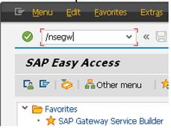

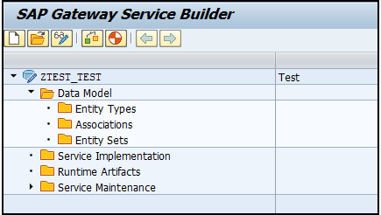
Gateway Service Builder – SEGW GWI-OVW:GWI-OVW-01
The Service Builder creates a new project structure, which you can use to develop or generate your new service

Slide 4
Steps Involved in Creating a Gateway Project GWI-OVW:GWI-OVW-01
Launch Transaction SEGW.
Click on Create.
In the Create Project dialog box, enter a unique name for your new project. The project name must not exceed 30 characters and must not start with a number or include any special characters (underscores are permitted). For example, ZTEST_TEST.
Enter a short description for your new project. You must enter a short description otherwise you cannot create the new project. The description must not exceed 60 characters. The short description should provide additional context information about your project. The short description you define here is displayed in the Service Builder together with the project name.
Under Attributes, click project type Service with SAP Annotations to enable you to use standard annotations (such as, creatable, updatable) to specify how data model artifacts are to be used.
Under Attributes use the input help to select Standard as the generation strategy to be used.
Enter the name of the package in which the project is to be created or choose Local Object if you want to create the project locally.
Click Enter to create your new project together with its unique name and description in the location you specified.

Slide 5
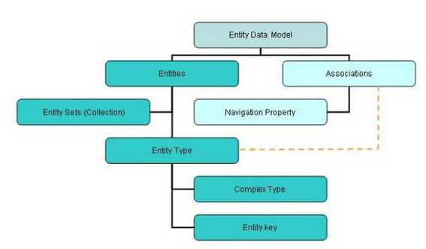
SEGW GWI-OVW:GWI-OVW-02
We need to be familiar with below terms before we start with any gateway development using Service builder transaction
- Entity Type
- Entity Set
- Association
- Navigation
- MPC( Model Provider Class )
- DPC( Data Provider Class )

Slide 6
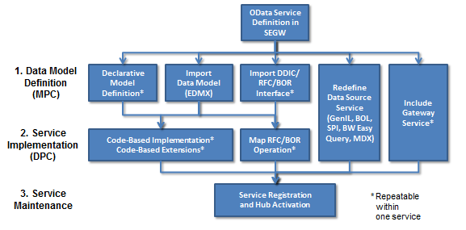
Data modeling in SAP Gateway GWI-OVW:GWI-OVW-03
OData services require a data model definition, referred as model provider class.. Based on your specific requirements, you can define a data model in the following formats:
Define new data model
Import
Redefine Service
Include Service

Slide 7
Gateway Model Builder
GW Model Builder:
Data Model
Service Implementation
Runtime Artifacts
Service Maintenance

Slide 8
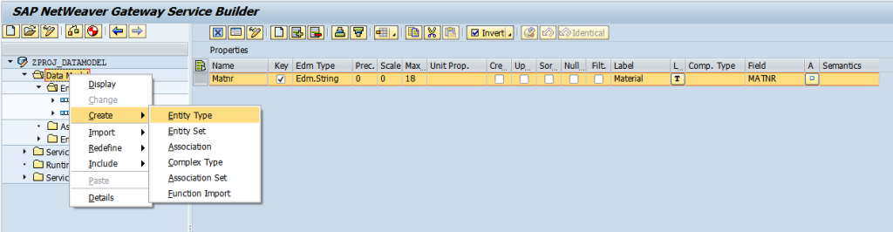
Data model elements GWI-OVW:GWI-OVW-03
This model offers optimum flexibility, wherein it requires manual definition of individual data model elements and their properties.
Within the tree view of the Service Builder, you can use the data model folder structure to create and edit the individual data model elements. The data model consists of various sub-folders for each of the element types as listed below:
Entity Types
Complex Types
Associations
Entity Sets
Association Sets
Function Imports

Slide 9
Development Phases for OData service
Model Provider Class (MPC)
Definition of individual data model elements and their properties
Data Provider Class (DPC)
Definition of runtime artifacts (operations & methods)
Code-based implementation
Mapping operations to a data source
Service Maintenance
Registering & activating the service

Slide 10
Gateway Model Builder
Runtime Artifacts :
When we generate the project in GW builder, the below classes are generated under the Runtime Artifacts.
Model Provider Class
Model Provider Extension Class
Data Provider Class
Data Provider Extension Class

Slide 11

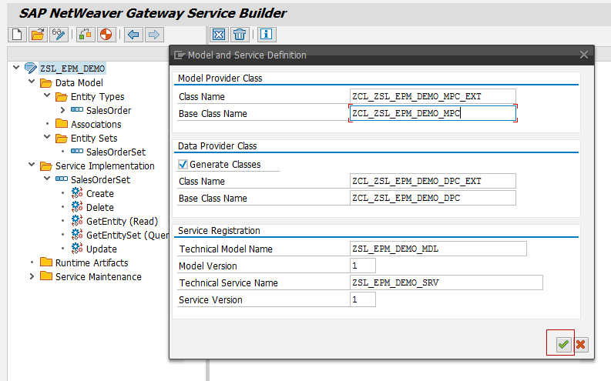
Creating the ABAP Classes GWI-OVW:GWI-OVW-03
Generate Button

Slide 12
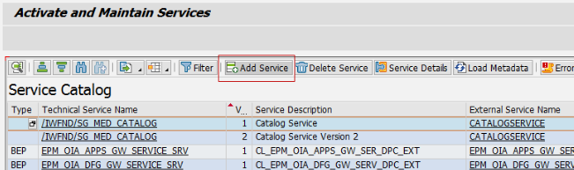
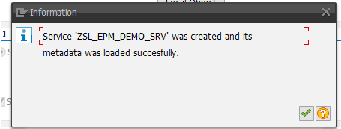
Registering the Service
To register the OData service, go to /IWFND/MAINT_SERVICE transaction.
Click on Add Service button to register the service
Search for the service name in the system where you have created your service. Click on Get Services
Hub Deployment – Provide the alias as your back-end system.
Embedded Deployment – Provide “LOCAL”
Select the service and Click in Add Selected Service button
Assign the package to the service and leave other fields as it is and Click on OK.
You will get below popup saying that service is registered successfully.

Slide 13
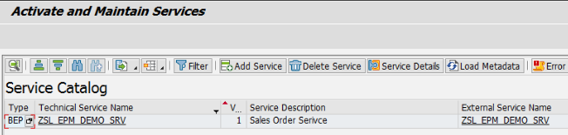
Service Maintenance GWI-OVW:GWI-OVW-03
We need to Register the service in the respective System Alias maintained in the Service Maintenance.
Once the Service is registered then we can maintain the service to test from Gateway Client.
Go back to service maintenance tcode /IWFND/MAINT_SERVICE, You will find the service and technical name of the service will be <ProjectName>_SRV.

Slide 14

Development Process
RFC/BOR
Client
Gateway Client
Consumer
1.Pre-Requisites (AddOn / SDK)
2.Define or Generate Meta data Provider Class
Model
3.Define or Generate Data Provider Class
Code
4.Register Service
Configuration
5.Test the service
Testing
6.Consume Service
OData Consumer

Slide 15
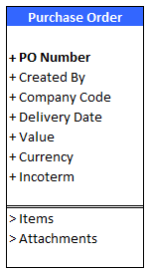
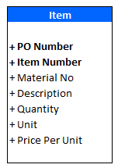
Entity Data Model
Entity Type :
Basic Building Block
Represents business object
At least one property must be nominated as key field.
Entity Type is built up of Properties.
Navigation :
Runtime implementation of an association.
Association : Declares that a relationship exists between two entity types

Slide 16
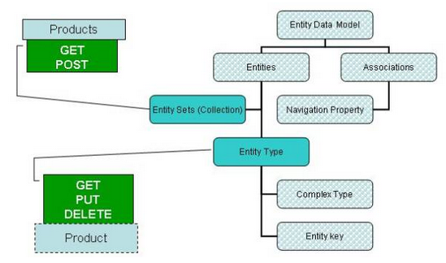
Possibility operations GWI-OVW:GWI-OVW-04
We can do a GET and POST request on an Entity Set while GET, PUT and DELETE can be done on an Entity.

Slide 17
CRUDQ Operations
Create
Used to create a one or more record in the backend system
Http method POST will be used to perform create operation
Get Entity (Read)
Used to populate only one record in the output response
Http method GET will be used to perform read operation
Update
Used to update a record in the backend system
Http method PUT will be used to perform update operation
Delete
Used to delete a record in the backend system
Http method DELETE will be used to perform delete operation
Get Entity Set (Query)
Used to populate one or more record in the output response
Http method GET will be used to perform query operation

Slide 18
Service Operations GWI-OVW:GWI-OVW-04
Service Operations:
- GetEntity
we can refer to as work area in ABAP
- GetEntitySet
we can refer to as internal table in ABAP
- Create
We can create only single record at once.
- Update
We can single only record at once.
- Delete
We can delete only single record at once.

Slide 19
Demo 1 : OData service with CRUDQ operations
Scenario:
Table : ZEMP_GW
FMs in the backend system :
ZCREATE_EMP_GW (Insert employee details)
ZDELETE_EMP_GW (Delete employee details)
ZQUERY_EMP_GW (Get employee list)
ZUPDATE_EMP_GW (Update employee details)
ZREAD_EMP_GW (Read employee details)

Slide 20
OData Query Options
Command operations used:
$filter
$top
$skip
$select
$count
$expand
$inlinecount
$orderby

Slide 21
OData Query Options (Continued…)
Paging >> $top & $skip
Service URI: /sap/opu/odata/sap/ZDT_MAPPING_SRV_01/EmployeeSet?$top=5
The first 5 employee records are returned
Service URI: /sap/opu/odata/sap/ZDT_MAPPING_SRV_01/EmployeeSet?$skip=5
The first 5 records are skipped and records from number 6 onwards are provided in the response
Service URI: /sap/opu/odata/sap/ZDT_MAPPING_SRV_01/EmployeeSet?$skip=5&$top=5
The first 5 records are skipped and the next 5 records are displayed i.e. from records 6 to 10

Slide 22
OData Query Options (Continued…)
Projecting >> $select
Service URI: /sap/opu/odata/sap/ZDT_MAPPING_SRV_01/PoHeaderSet?$select=PoNumber,TargetVal,Currency
Only the PO Number, Target Value and Currency are returned in the output response
Filtering >> $filter
Service URI: /sap/opu/odata/sap/ZDT_MAPPING_SRV_01/PoHeaderSet?$filter=CoCode eq ' 1000‘
All the records with Company code equal to ‘1000’ are returned in the output response
Count >> $count
Service URI: /sap/opu/odata/sap/ZDT_MAPPING_SRV_01/PoHeaderSet/$count
Returns the number of records in the output response

Slide 23

ANY QUESTIONS

